Slide 1

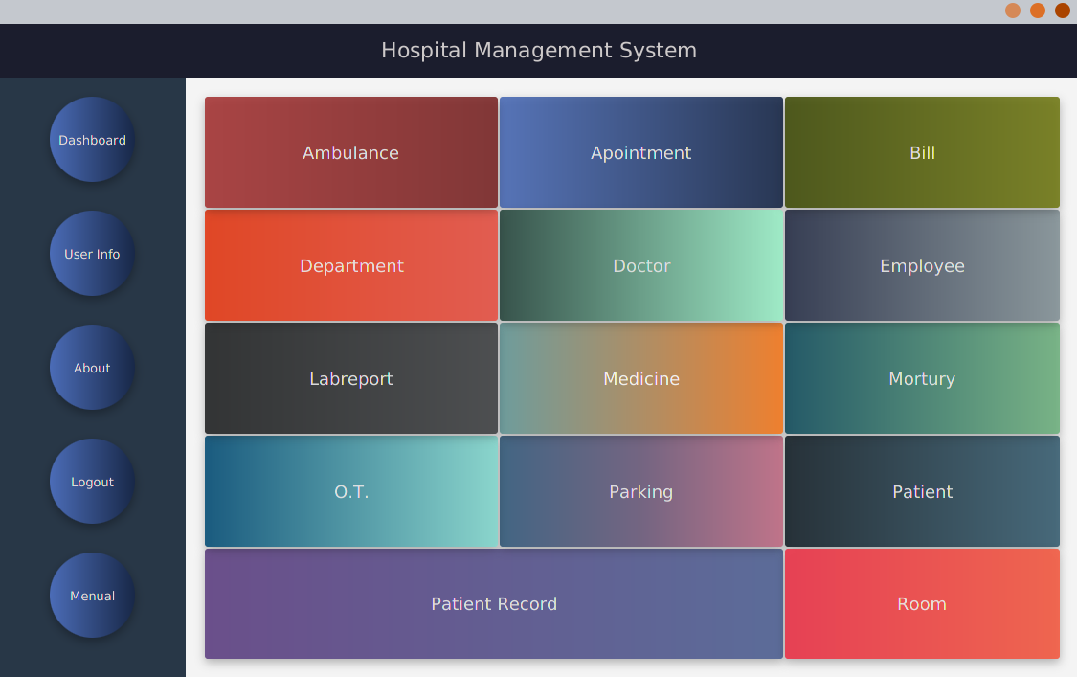
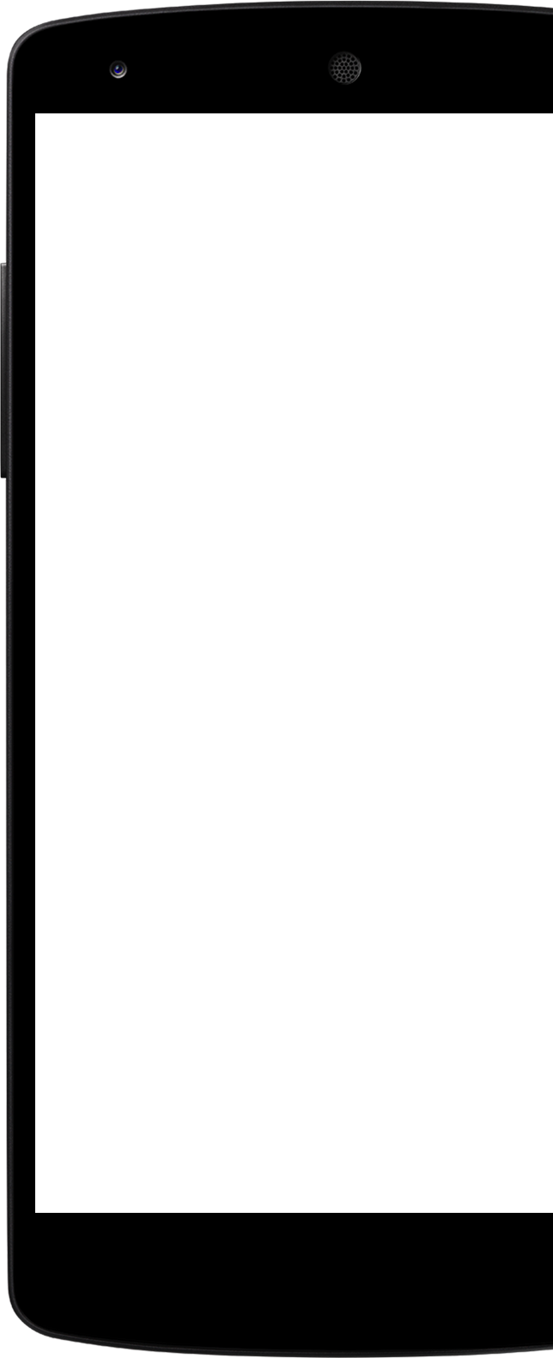
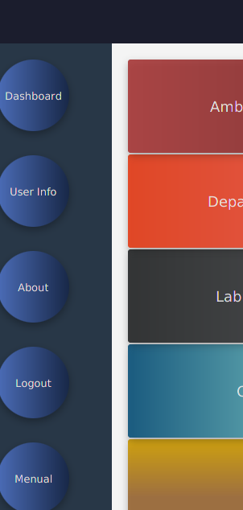
Hospital
Management System

Slide 2
Outline
Features
User & Work done
Diagrams
Feature Use

Slide 3
Features

Slide 4
Feature
List
Here are the features you can use.
Ambulance Patient
Appointment Patient Record
Bill Room
Department
Doctor
Employee
Lab Report
Operation Theater
Parking

Slide 5
User & Work Done

Slide 6
User
Here two kind of user can use this app.
Employee
Admin

Slide 7
Work done of
Our Project
95%
We have covered
We have done those features and also tried to cover maximum work process in a hospital.

Slide 8

Supporting
Sector
You can collect our project from below link. https://github.com/HEDAETUL-ISLAM/Project
Database Designer Faisal Abdullah,Fokrul Islam
Apps Frontend, Backend by Hedaetul Islam

Slide 9
Diagrams

Slide 10
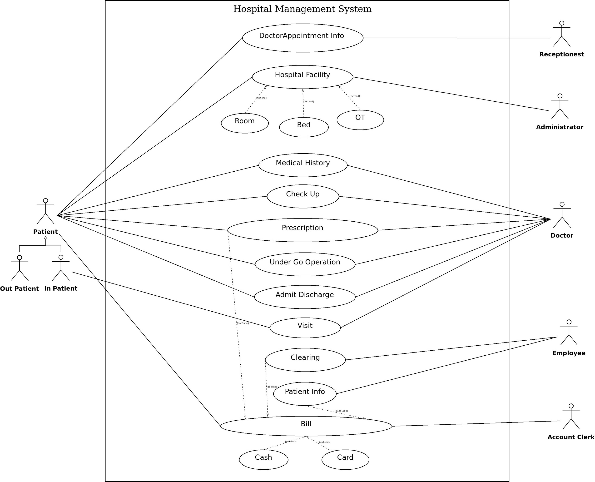
Use case

Slide 11
Class Diagram

Slide 12
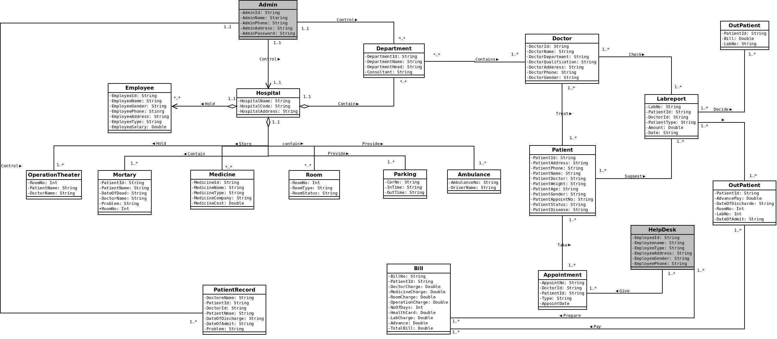

Slide 13
ERD Diagram

Slide 14
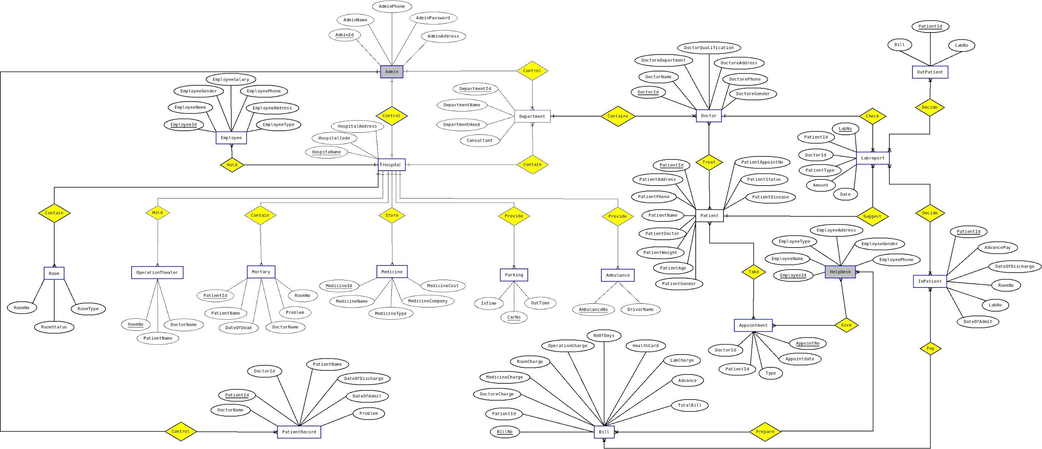

Slide 15
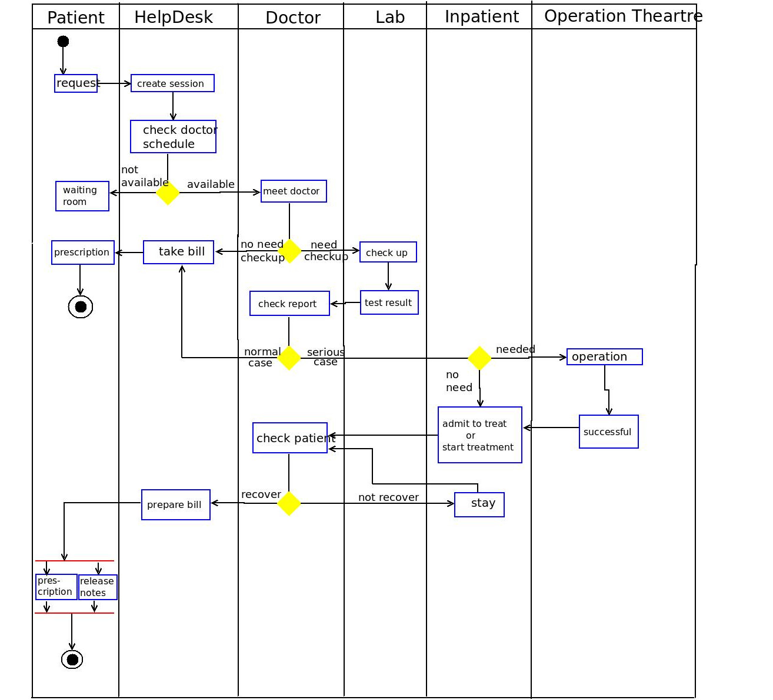
Activity
Diagram

Slide 16
Feature Use

Slide 17
Home Page
For Admin

Slide 18
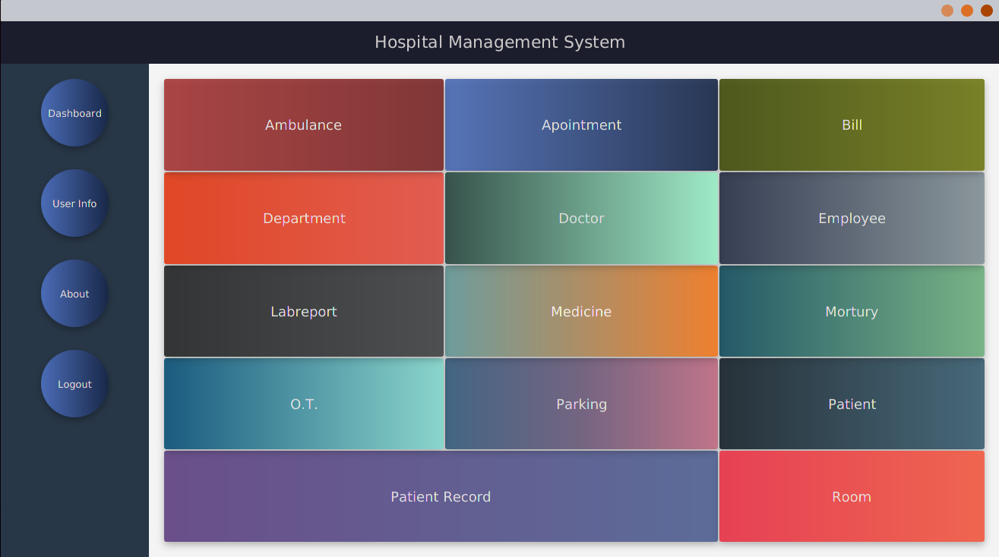
Home Page
For
HelpDesk

Slide 19
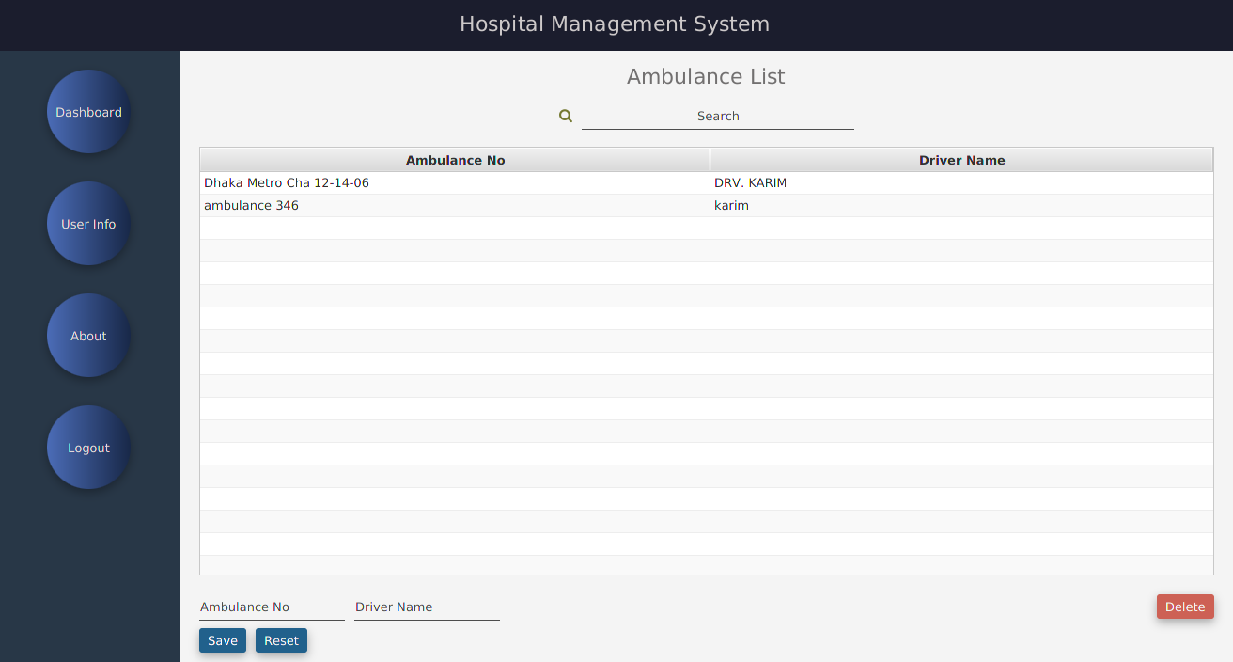
Ambulance

Slide 20
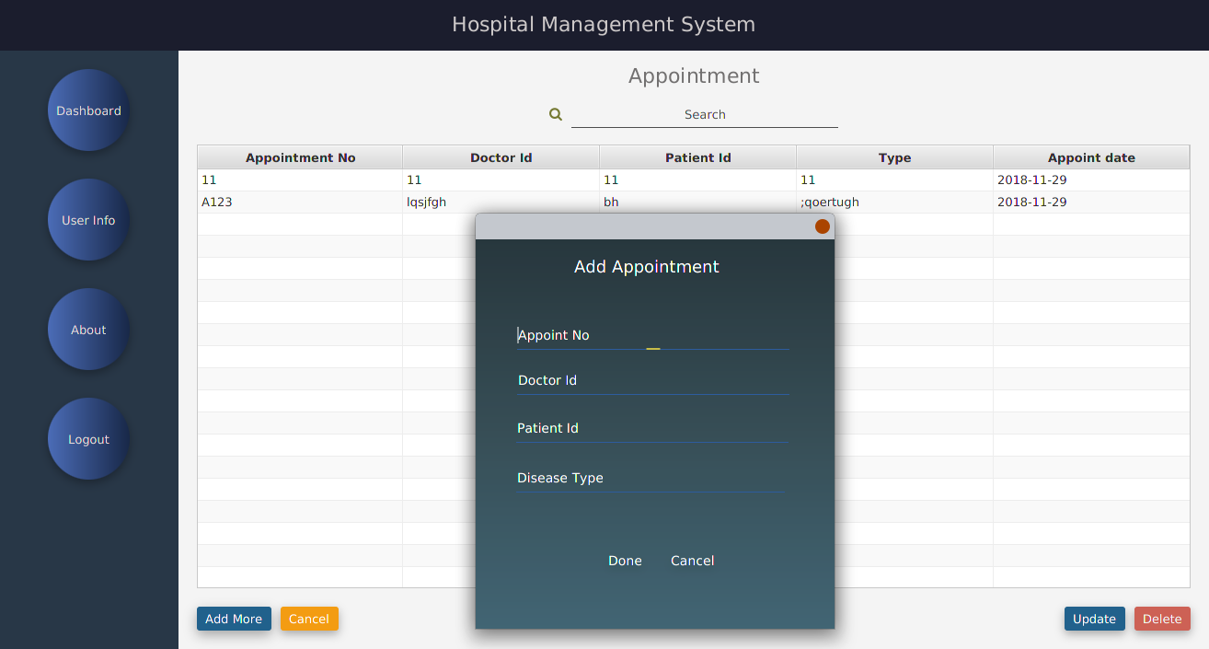
Appointment

Slide 21
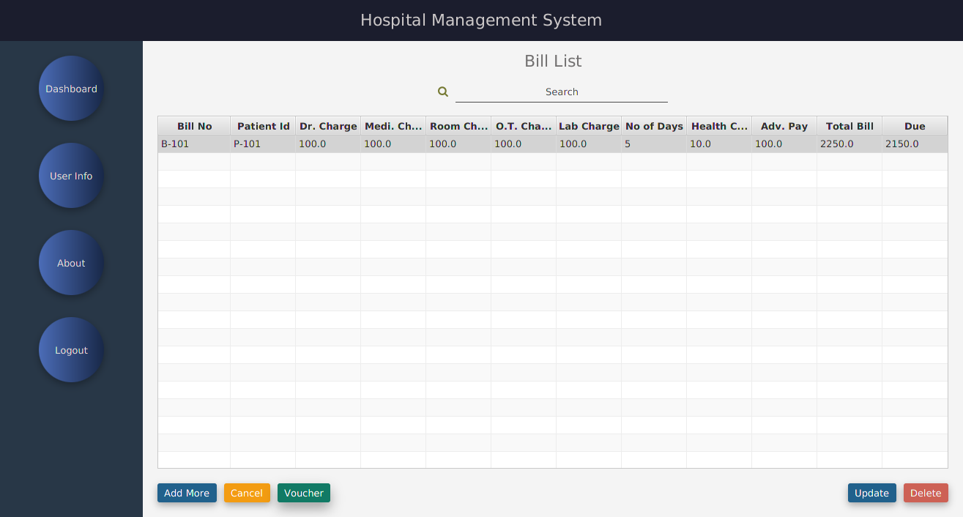
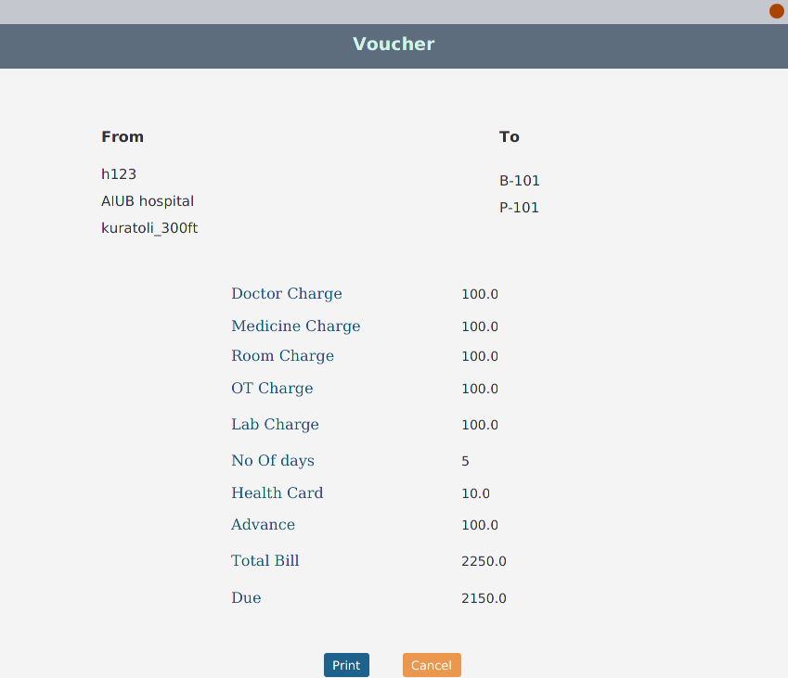
Bill

Slide 22
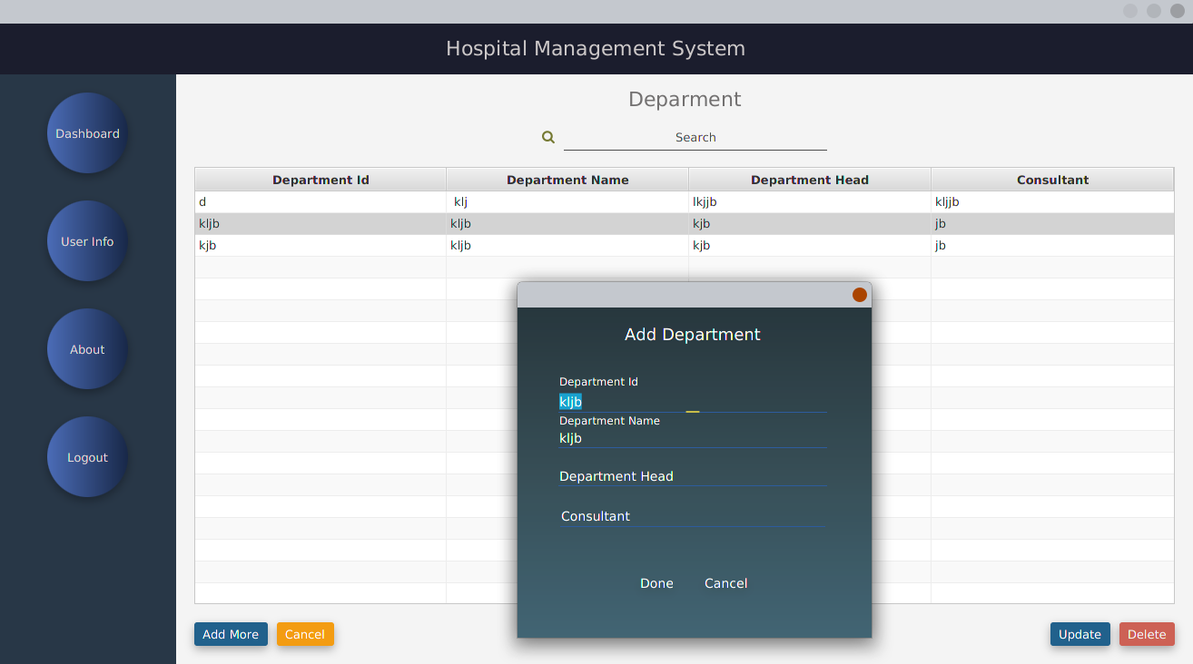
Department

Slide 23
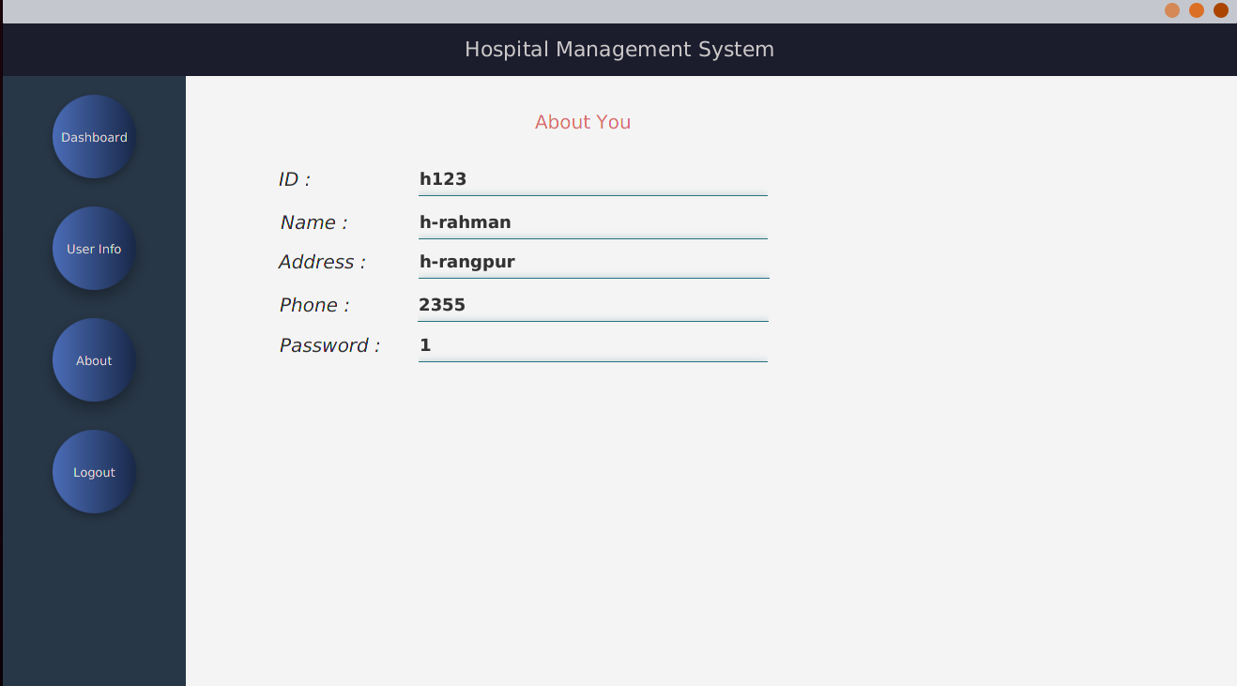
User info

Slide 24
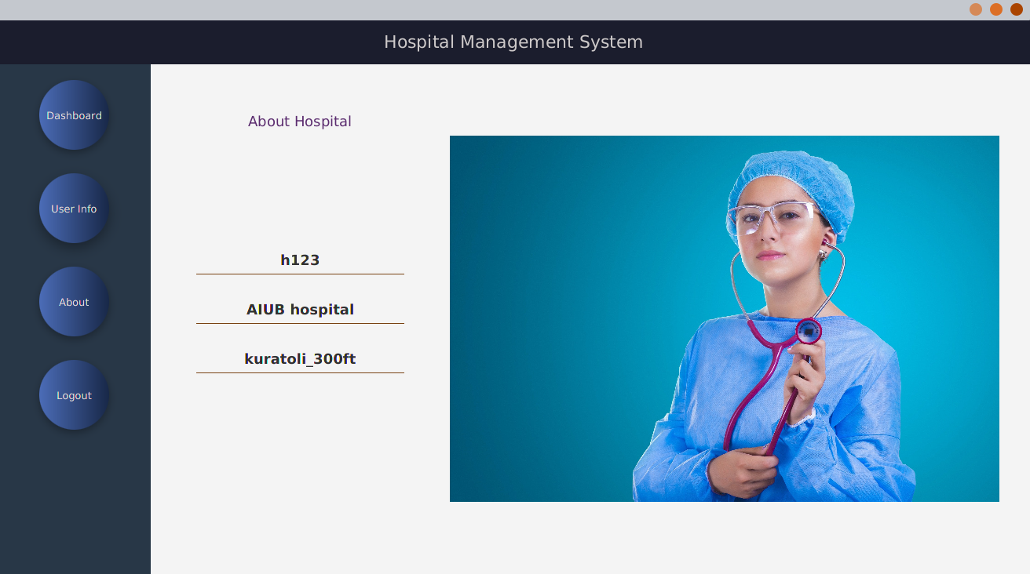
About
Hospital

Slide 25
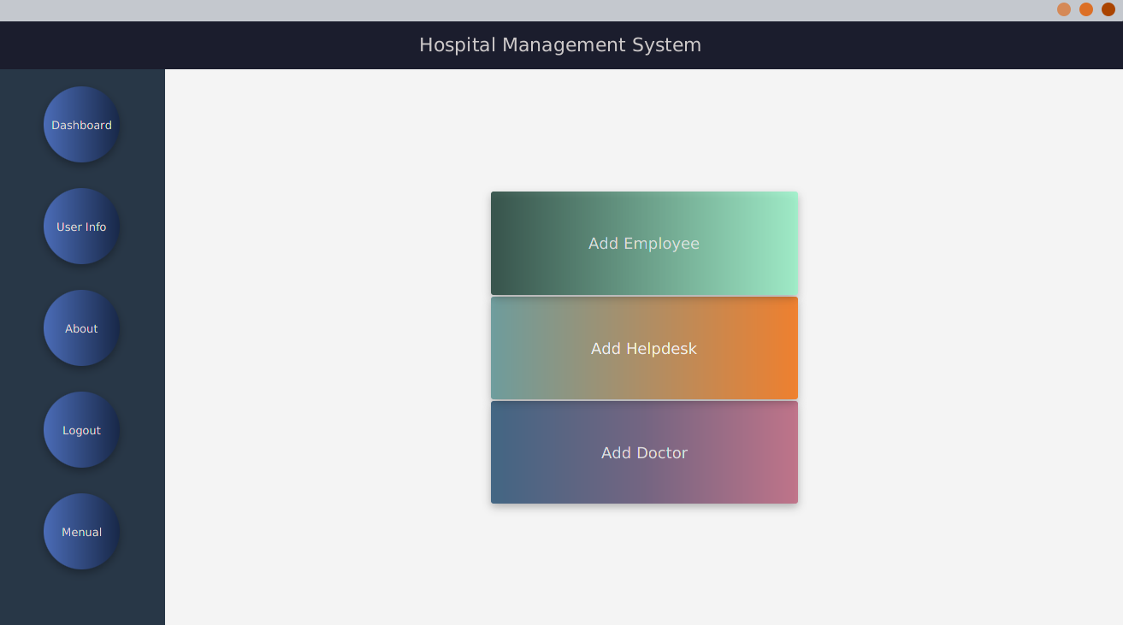
Only for
Admin

Slide 26
Why it’s better than analog system ?
Now everything is computerized. So in short time if we can do any work easily then why we will backdated !!

Slide 27
Technology
Java Raw for Backend
JavaFx for Frontend
Database Oracle
Also all API for web version by Java Spring
Also ready for MySQL

Slide 28
Questions?

